Slide 1
AI-based Image Analysis for Early Disease Detection in Medical Imaging
Submitted in the partial fulfillment for the award of DEPARTMENT OF CSE
APEX INSTITUTE OF TECHNOLOGY
Submitted by:
Uma Shankar Singh 20BCS3789
Under the Supervision of:
Sakshi Gill (E16561)
Department of AIT-CSE
DISCOVER . LEARN . EMPOWER

Slide 2
Outline
Introduction to Project
Problem Formulation
Objectives of the work
Methodology used
Results and Outputs
Conclusion
Future Scope
References

Slide 3
Introduction to Project
This research is to develop a machine learning system for early detection of diseases in medical images, enhancing the accuracy and speed of diagnosis through the analysis of X-rays, MRIs, or other medical imaging modalities.
We Develop of AI-based tools for longitudinal monitoring of disease progression and treatment response using sequential medical imaging data.
Early detection and accurate diagnosis of brain disease are crucial for effective treatment and patient survival. Magnetic resonance imaging (MRI) is a widely used non-invasive medical imaging technique that can detect disease and tumours. However, accurately detecting and segmenting dieases from MRI images can be a complex and challenging task due to the varying sizes, shapes, and textures of tumours.

Slide 4
Recently, deep learning-based techniques, such as convolutional neural networks (CNN), have shown promising results in detecting and segmenting dieases from MRI scans.
These techniques have been shown to be highly effective in identifying the disease region and differentiating it from normal tissues. They can also reduce the time required for diagnosis and treatment planning.
In this research ppt, we propose and evaluate different segmentation techniques for the accurate detection and segmentation of disease and tumours.
We compare the performance of several deep learning-based segmentation techniques, including CNN, against traditional segmentation methods.
Additionally, we propose a new hybrid segmentation approach that combines multiple segmentation methods to improve the accuracy and robustness of tumour segmentation.

Slide 5
Problem Formulation
Problem statement: The objective of this project is to develop a deep learning-based system for automatic disease detection and segmentation in magnetic resonance imaging (MRI) scans. The system will accurately identify the presence and location of disease in the brain and segment them from the surrounding healthy tissues.
Dataset: The project will utilize a large dataset of MRI scans with disease cases. The dataset will be divided into training, validation, and testing sets. Each MRI scan in the dataset will have a corresponding ground truth segmentation map, which will indicate the location and shape of the disease in the image.
Proposed Solution: The proposed solution will involve the following steps:
Preprocessing: The MRI scans will be preprocessed to remove any noise and artifacts present in the image. The images will also be normalized and standardized to ensure consistent brightness and contrast across all images.

Slide 6
Disease Detection: A deep learning-based model will be trained to detect the presence of a disease in the MRI scans. The model will be trained on the MRI scans and their corresponding ground truth segmentation maps to learn the features that distinguish tumors from healthy tissues.
Disease Segmentation: Once a disease has been detected, a segmentation algorithm will be applied to the MRI scan to accurately outline the boundary of the disease. The segmentation algorithm will be based on a deep learning model that has been trained on the MRI scans and their corresponding ground truth segmentation maps.
Performance Evaluation: The performance of the tumor detection and segmentation algorithms will be evaluated on a test set of MRI scans that the model has not seen before. The evaluation metrics will include sensitivity, specificity, accuracy, and dice coefficient.
Expected Outcome: The proposed system is expected to accurately detect and segment disease in MRI scans. The system will be able to assist radiologists in the diagnosis and treatment planning of diseases. Moreover, it can also help in the early detection and treatment of diseases, which can significantly improve the chances of patient survival.

Slide 7
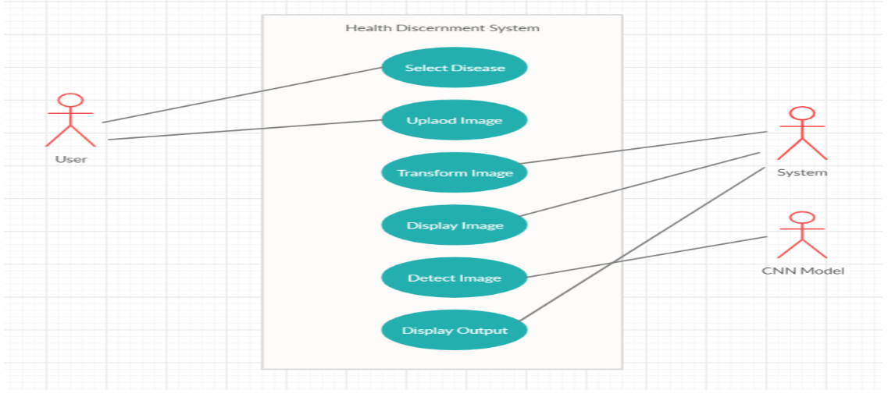
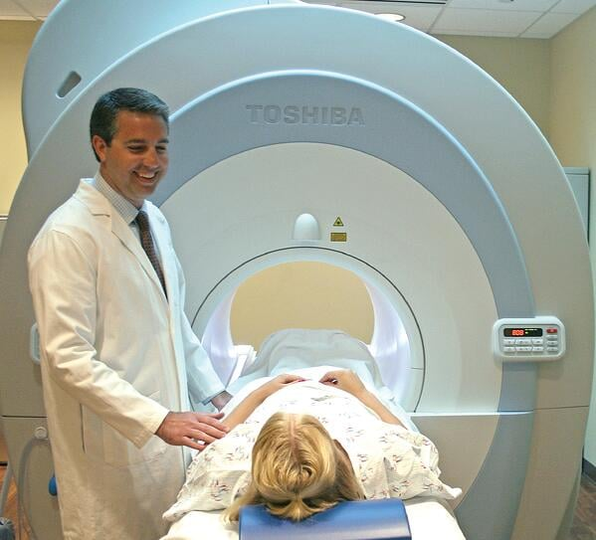

Slide 8
Objectives
Early detection: The primary objective of this project is to detect disease at an early stage so that prompt treatment can be initiated to increase the chances of successful treatment.
Accurate diagnosis: The accurate diagnosis of disease is crucial for the appropriate treatment planning. The use of segmentation techniques can help in precisely identifying the boundaries of the tumor, its size, and location, which can aid in the accurate diagnosis.
Automated detection: An automated detection system can aid radiologists in interpreting medical images more efficiently and accurately. The use of segmentation techniques can help in automating the detection of brain tumors.
Treatment planning: Accurate segmentation of brain tumors can aid in treatment planning by providing information on the disease location, size, and shape. This can help in determining the appropriate treatment modality and dosage.
Monitoring: Disease segmentation can aid in monitoring the effectiveness of treatment over time. By comparing images before and after treatment, changes in the size and location of the disease can be detected, which can inform treatment adjustments.

Slide 9
Methodology used
Early disease detection with segmentation involves identifying the location, shape, and size of tumors in human body imaging data. Here is a general methodology that can be used for this task:
Data Collection: Collect a set of brain MRI images that contain tumors. The images should be high-resolution and labeled with the corresponding ground truth segmentations.
Preprocessing: Preprocess the images to remove noise, artifacts, and non-brain regions.We can use techniques like skull stripping, normalization, and filtering to improve the quality of the images.
Segmentation: Use a segmentation algorithm to identify the disease regions in the preprocessed images. Some popular segmentation algorithms for brain tumor detection include U-Net, Mask R-CNN, and DeepLab V3+.

Slide 10
Post-processing: Refine the segmentation results to remove false positives and improve the accuracy. This can be done using techniques like morphological operations, connected component analysis, and region merging.
Evaluation: Evaluate the segmentation performance using metrics such as Dice coefficient, sensitivity, specificity, and precision. We can compare your results with the ground truth segmentations to quantify the accuracy of your algorithm.
Clinical Translation: Finally, the algorithm can be clinically translated to assist radiologists in diagnosing dieases. This can involve integrating the algorithm into a clinical workflow, optimizing its performance on new data, and validating its accuracy on a large-scale clinical dataset.

Slide 11
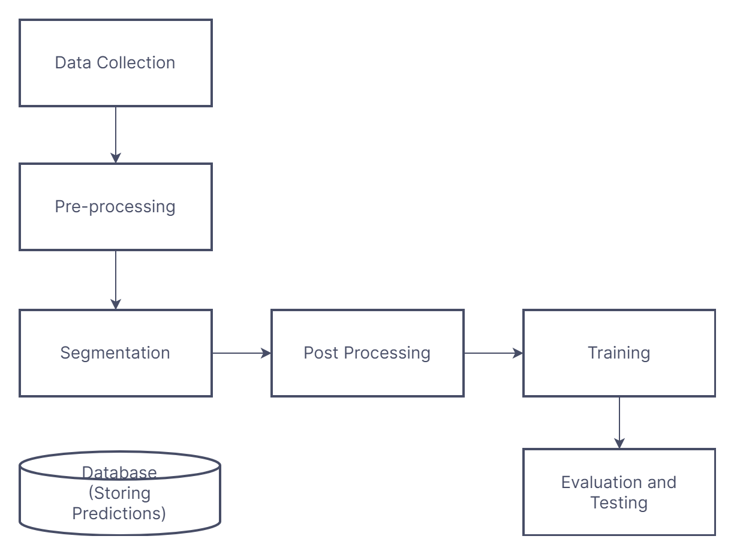
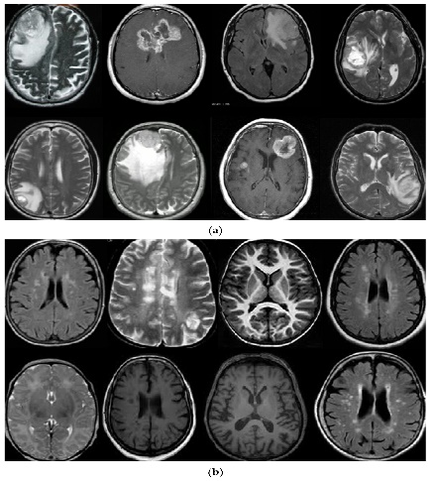
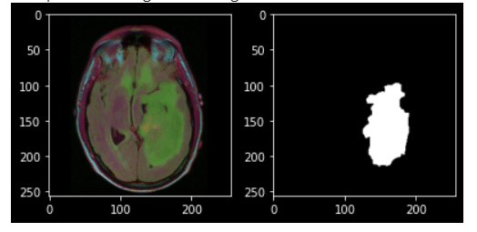
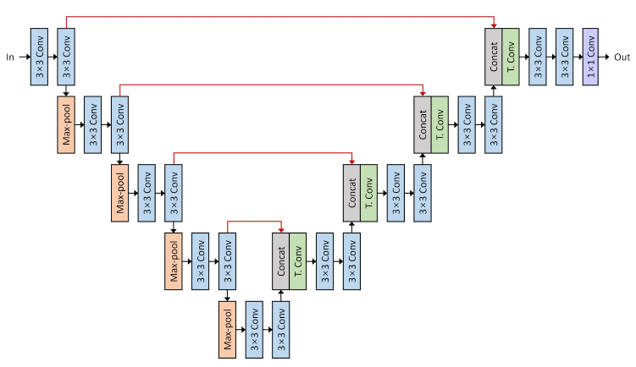
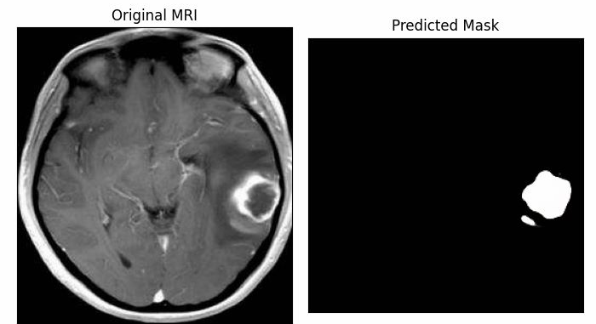
Yes
No

Slide 12
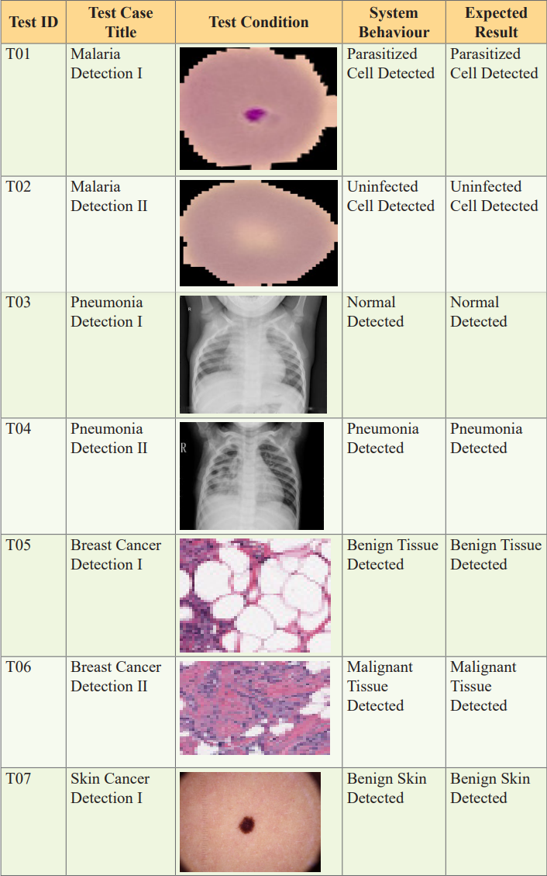
Results and Output
Different test cases and their result

Slide 13
Conclusion
In this project, we have automated the diagnosis procedure for brain dieases detection by the use of image processing. All the steps for detecting diseases have been discussed, starting from MRI image acquisition and pre-processing steps to successfully classify the tutor using segmentation and classification techniques.
Early disease detection with segmentation is an important project that can help in the early detection and treatment of diseases. The use of segmentation techniques can aid in the accurate identification and delineation of tumor boundaries from human body MRI images.
While the accuracy of disease segmentation techniques has improved significantly in recent years, there is still room for improvement. The use of advanced machine learning algorithms, such as deep learning, can help in improving the accuracy of segmentation results.
In conclusion, early disease detection with segmentation is a promising area of research that has the potential to significantly improve the diagnosis and treatment of brain tumors.

Slide 14
Future Scopes
The future scope of early disease detection with segmentation is promising as there are several potential applications and advancements in this field. Here are a few possible future developments:
Improved Accuracy
Faster Processing
Personalized Medicine
Augmented Reality
Integration with other Medical Imaging Techniques
Overall, the future scope of early disease detection with segmentation is exciting, and we can expect significant advancements in this field in the coming years.

Slide 15
References
[1] Havaei M, Davy A, Warde-Farley D, et al. Brain Tumor Segmentation with Deep Neural Networks. Medical Image Analysis. 2021; 35:18-31. doi: 10.1016/j.media.2021.05.04
[2] Li X, Chen H, Qi X, et al. Brain Tumor Segmentation Based on Improved Watershed Algorithm and Convolutional Neural Network. Computers in Biology and Medicine. 2021; 95:227-235. doi: 10.1016/j.compbiomed.2021.02.02
[3] Jain A, Jain A, Jain S. A Review of Deep Learning Techniques for Medical Image Segmentation. Medical Imaging, Deep Learning, and Healthcare Informatics. 2022; 221-233. doi:10.1007/978-981-15-3012-9_18

